Slide 1
CODSOFT UX/UI DESIGN INTERNSHIP
By Rashmi Kiran
An internship that will help you grow with four task that is been provided.

Slide 2
Task 1: Mobile Application sign-up flow
A mobile app signup flow is the process of users creating an account and signing up for an app. The goal of a good signup flow is to make it easy and quick for users to sign up, while also collecting the necessary information from them.
The mobile app signup flow can have three condition: first when account is not created, second when invalid I’d or password is added, and lastly when we enter the correct credentials.
There are three scenarios that we might encounter: 1. Invalid ID and Password: If we use the email amangupta654@gmail.com and password "aman12345" and it is invalid, we will create a new account. Once the account is created, we can access the homepage. 2. Invalid Password: If we enter a valid email ID but an invalid password, we will receive an OTP on the registered email address to reset the password. 3. Login via Email and Twitter: We can log in using either our registered email ID or Twitter account.
LinkedIn Post: https://www.linkedin.com/posts/rashmi-kiran-uidesignercumapoet_uxdesign-uidesign-firsttaskcomplete-activity-7118847854554574848-LBYH?utm_source=share&utm_medium=member_desktop
Behance Link: https://www.behance.net/gallery/182249415/Mobile-Log-in-Flow

Slide 3
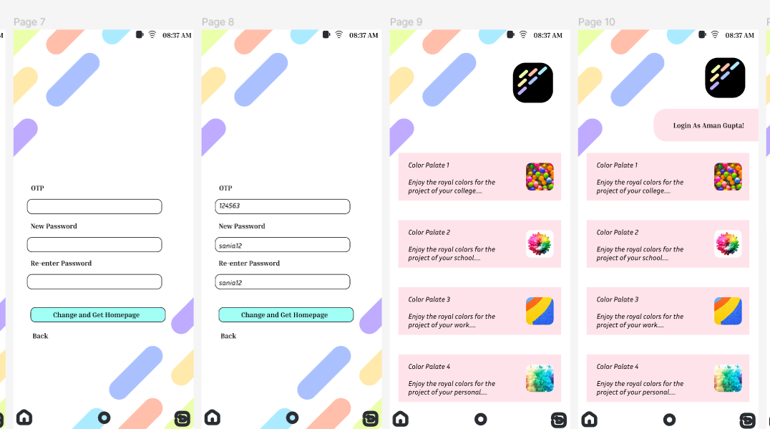
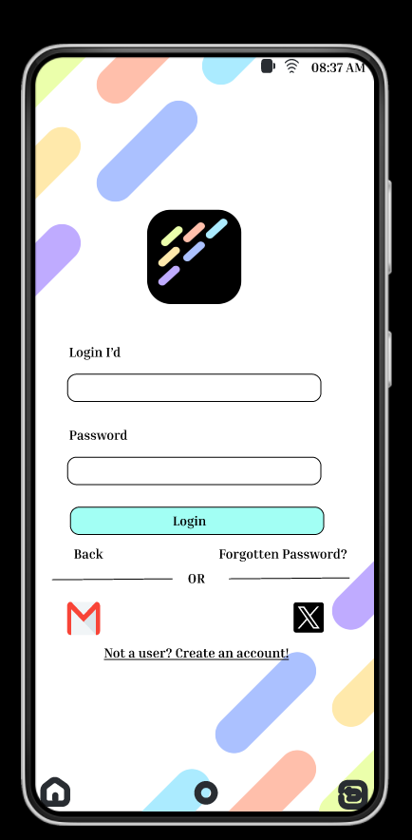
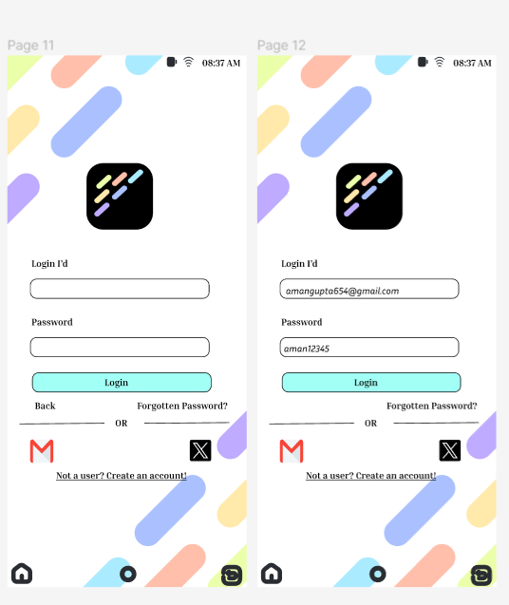
Colour palette

Slide 4
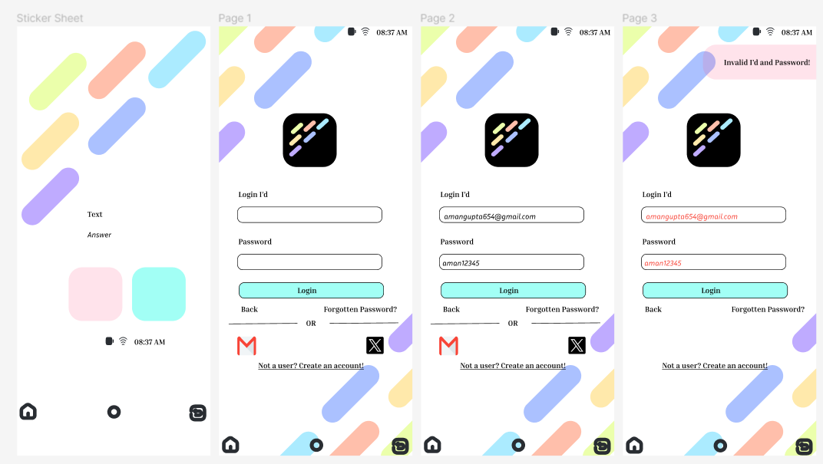
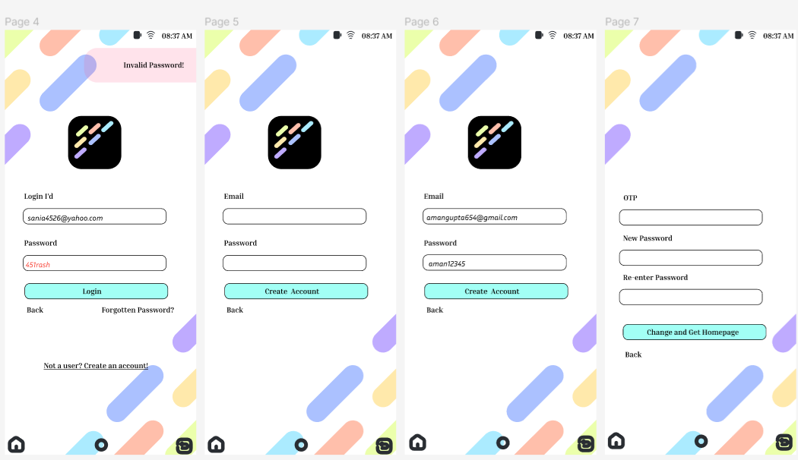
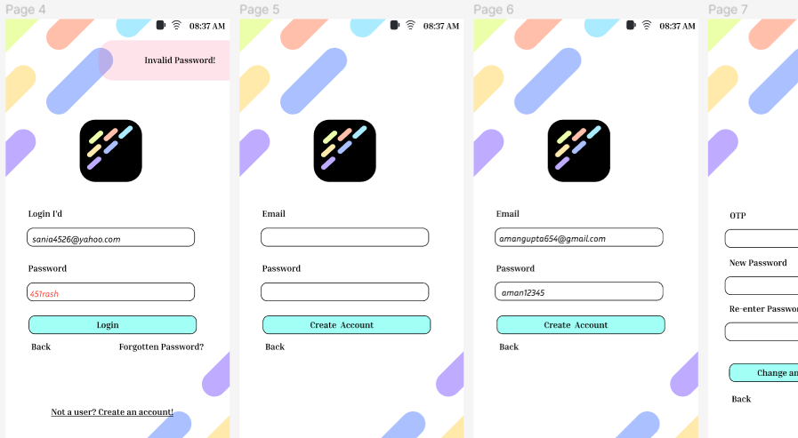

Slide 5
Task 2: email template
An email template is a pre-designed email that can be used to send out marketing or promotional emails. The goal of a good email template is to make it easy and quick for businesses to send out emails that look professional and engaging.
It’s a website that helps with digital marketing services like SEO, Content Writing, Keyword, and all other things.
We have an email template that can assist you in subscribing to our newsletter and utilizing our company's services, which include content writing, copywriting, SEO, and analytics. You can subscribe to the newsletter by providing your email address. Additionally, you can provide your email address and specify the service you require, and our company will contact you shortly. We have provided an email ID through which people can contact our company.
LinkedIn: https://www.linkedin.com/posts/rashmi-kiran-uidesignercumapoet_codsoft-uxdesign-uidesign-activity-7118848409079300096-M-p4?utm_source=share&utm_medium=member_desktop
Behance: https://www.behance.net/gallery/182249635/Email-Template

Slide 6
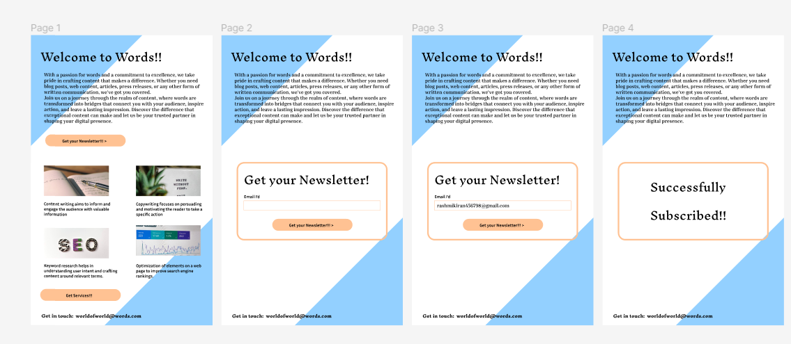
Email Template

Slide 7
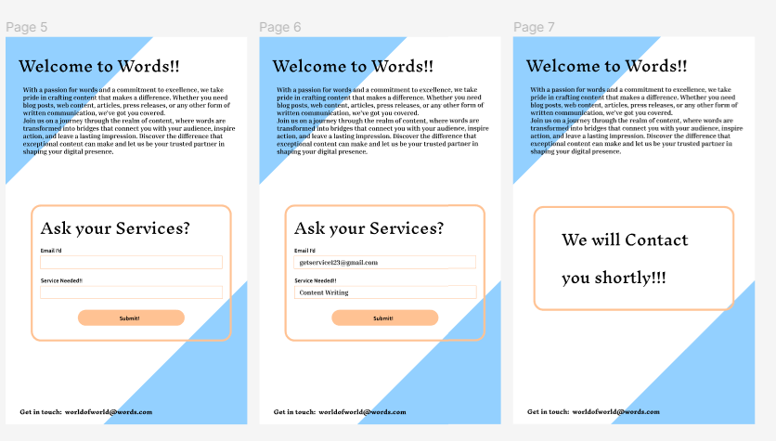
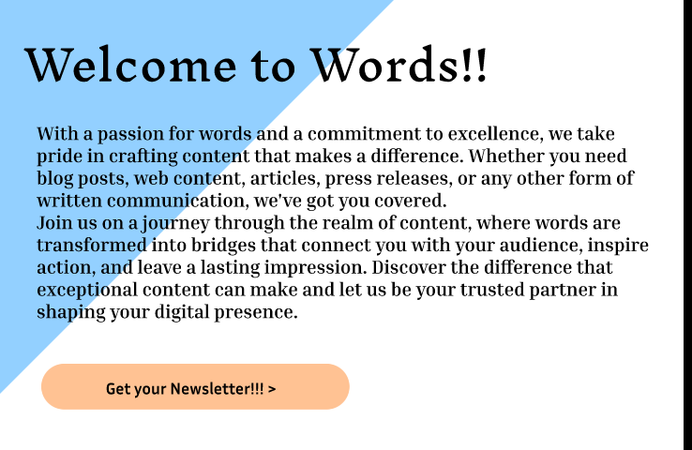

Slide 8
Task 3: restaurant Menu
A restaurant menu UI/UX project is the process of designing a menu that is both visually appealing and easy to use. The goal of a good restaurant menu is to make it easy for customers to find the dishes they want, and to encourage them to order more.
A Restaurant Menu that is made for the small restaurant which has few options, that is basically for small cafes where people meet.
This is the restaurant menu. It is not fully automatic, but rather semi-automatic. It is an electronic menu, which means you can access it on your device. Once you have decided what to order, you can call the waiter by clicking on a button provided on the menu. We can customize the menu by editing the prices, food items, and descriptions according to the restaurant's preferences. The menu is user-friendly, with easy navigation and a visually appealing design.
LinkedIn: https://www.linkedin.com/posts/rashmi-kiran-uidesignercumapoet_codsoft-uxdesign-uidesign-activity-7119009905872711680-APuW?utm_source=share&utm_medium=member_desktop
Behance: https://www.behance.net/gallery/182279979/Restaurant-Menu

Slide 9
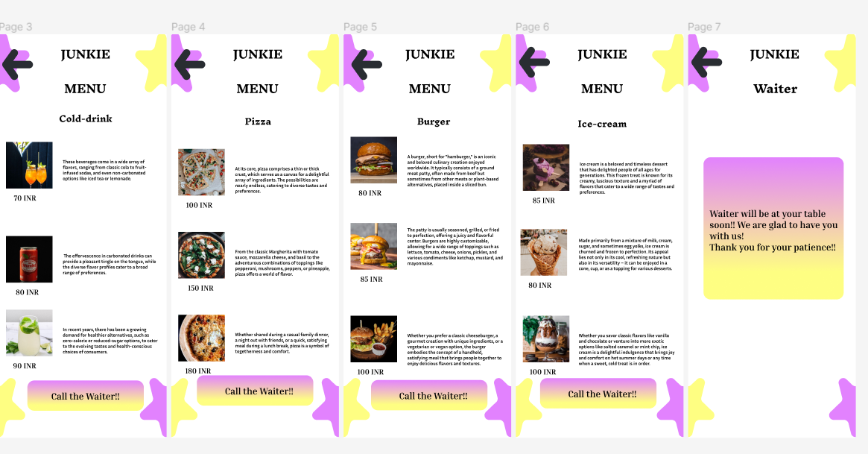
Junkie

Slide 10
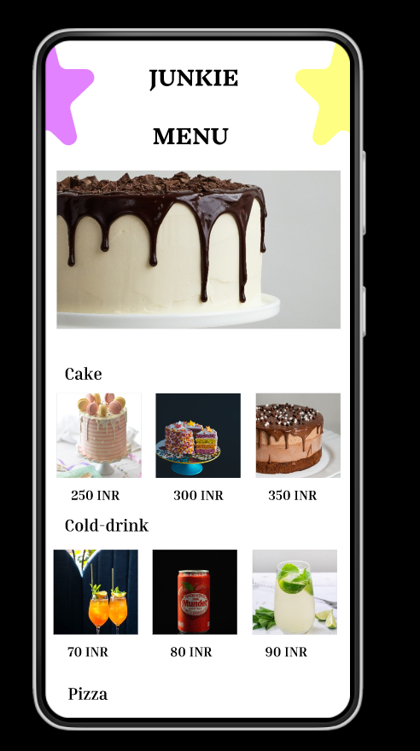
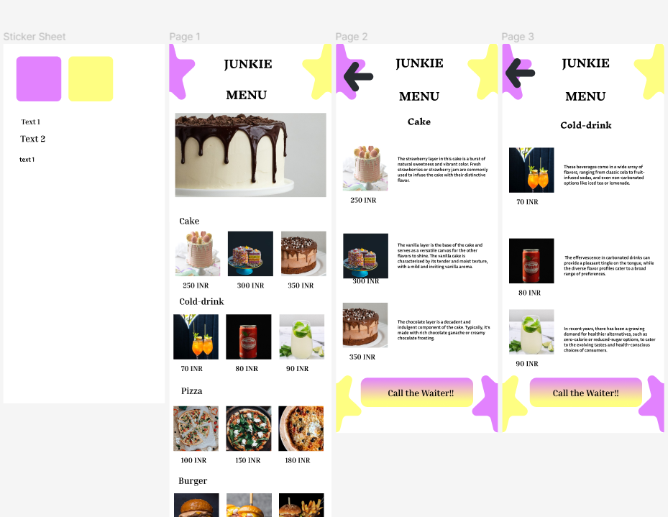

Slide 11
Task 4: E-commerce website
An e-commerce website UI/UX project is the process of designing an online store that is both visually appealing and easy to use. The goal of a good e-commerce website is to make it easy for customers to find the products they want, and to encourage them to buy them.
E-commerce website that helps you to buy teddy bears, it has several types of teddy. All you need to size and color of the teddy. And it will give you teddy at your door-step.
This is a small e-commerce website that sells teddy bears. The website offers three sizes of teddy bears: small, medium, and large. Customers can easily place an order and customize the color and other attributes based on the website owner's available options. There is a user profile page, along with sections for About Us and Policy. Overall, it is a simple and convenient platform for buying teddy bears.
LinkedIn: https://www.linkedin.com/posts/rashmi-kiran-uidesignercumapoet_codsoft-uxdesign-uidesign-activity-7119010965928472576-yMOh?utm_source=share&utm_medium=member_desktop
Behance: https://www.behance.net/gallery/182280339/E-commerce-Website

Slide 12
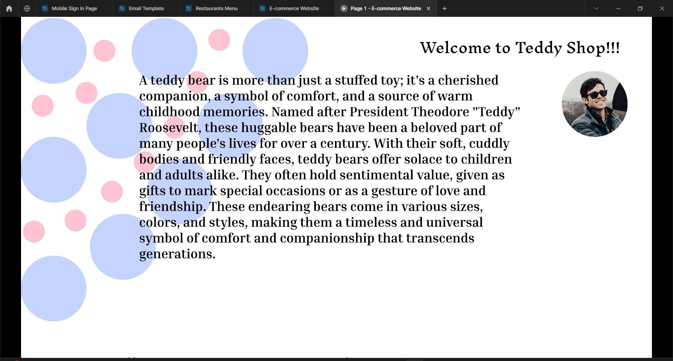
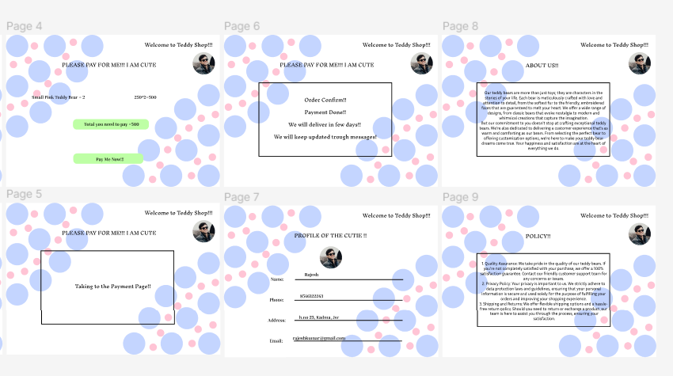
E-commerce website

Slide 13
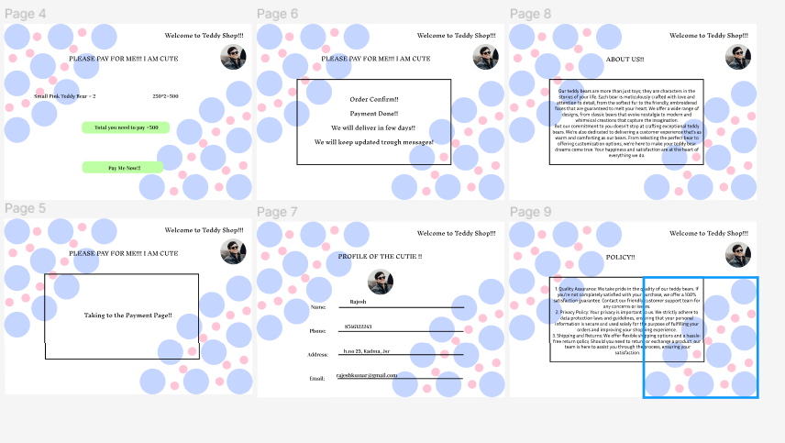
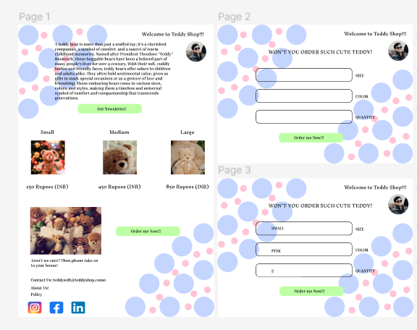

Slide 14
THANK YOU!!!
HAVE A GREAT DAY!!!

